Slide 1
User Requirements
Software Engineering
Neil Toporski

Slide 2
User Requirements
The process of understanding what the user (client) wants and organizing that information into “bite-sized” functionality where the project team understands how the product should work and how to proceed with product development.

Slide 3
User Requirements
Most projects fail because of inadequate requirement elicitation
Poor communication
Project delays
Cost overruns
Poor user acceptance
They don’t address “what does the user want?”

Slide 4
Requirements Solicitation and Definition
Interview
Get an overall understanding of what the stakeholders want to do.
How will they and/or users interact with the system?
Don’t ask leading questions.
Don’t use “techno-eze.”
Ask the W’s to dig deeper and obtain more granular responses/requirements.
What
Why
Who
Where
When
*How (not really a W)
Notes:
Have the sponsor explain how it all works

Slide 5
Requirement Solicitation and Definition
Describe
Capture a description of a product feature from a user’s perspective.
Describe the type of user, what they want and why.
Create a simplified outline of a requirement.
Notes:
Before putting it in the backlog, there are many different requirements. As a team, take a look at all the stuff and try to simplify and put that together in an outline
Then PO has understanding of how to move it into the backlog

Slide 6
Requirements Solicitation and Definition
Define
Outline all product features (requirements).
Prioritize requirements according to development stages.
Create a simplified statement for each requirement describing it’s function. (epics)
Further delineate (make more granular) into “bite-sized, detailed, and programmable” requirements. (user stories)

Slide 7
User Stories vs Acceptance Criteria
User stories are short descriptions of functionality told from the user’s perspective. The focus is on why and how the user interacts with the software.
Acceptance criteria often accompanies the user story. These criteria are the boundaries of the user story (feature) and they essentially determine when the user story is completed. Acceptance criteria is also what the tester will write/conduct their tests against. You can think of acceptance criteria as the functional requirements that support a user story. They confirm priorities and integrate the user’s perspective into the development team’s approach.
Notes:
Criteria close to the task

Slide 8
Requirements Solicitation and Definition
Develop a set of prioritized requirements (user stories with acceptance criteria for a potential product backlog for the following:
As a client, I would like a (scenario/case) -based decision tree to evaluate the performance of (students/employees/trainees) responses and actions given an engaging (real world/authentic) (situation/problem) to solve. This product should be highly visual and incorporate many forms of media. Moreover, it should be (accessible/available) to others who wish to build their own case based scenarios.
Notes:
This is what Is wanted

Slide 9
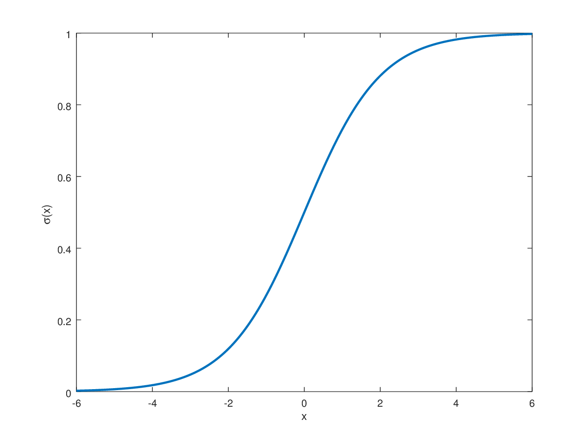
Good Enough Theory (again)
The process of creating requirements is complex.
Requirements can not simply be written by sitting down and bashing out a ream of detail based on a white-board session with the business. The process of creating a set of requirements itself contains a series of iterations where early concepts are discovered and developed, simplified, and sometimes eliminated. Too often this part of the process is confined to the original briefing session.
Result
Effort

Slide 10
Requirements
Requirement Elicitation
Stakeholders don’t always know what they want
Stakeholders express requirements in their own terms
Different stakeholders may have conflicting requirements
Requirements may change
Requirement Discovery
Conversational: User stories
As a < type of user >, I want < some goal > so that < some reason >
Non-technical language
Every story should have a descriptive title
Architecture Flow
Rudimentary workflow flowchart
Prioritization of Requirements
Epics
Thematic “chunks” of user stories
User Stories
Short, detailed, simple description of a feature told from the user perspective of how the system should work
Acceptance Criteria
Given [context] when [a specific action is performed] then [a set of consequences should occur]
Non-technical language
“Executable”, “test-able”
Can be a task (e.g. clicking the “My Account” link takes the user to the “My Account” page)
Notes:
Make sure you’re using common terminology (when writing PID, include this in a list of common definitions and terms to make it understandable)
2.2 Actual user stories going in the backlog
3. Come up with a visual/schematic and how it looks altogether (needs in PID) → can see interdependencies w/ visuals
5. First sitting as a team, the PO creates requirements, epics, user stories → chunk and prioritize it
7. What are the tasks for each user story

Slide 11
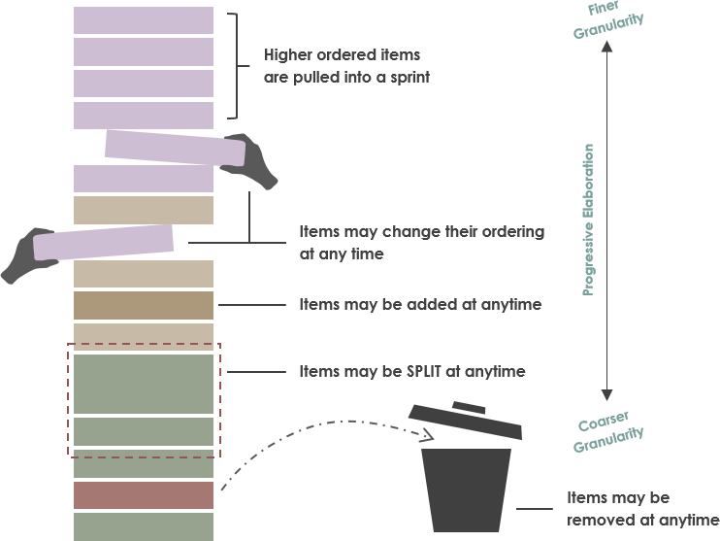
Product Backlog
The Product Backlog is essentially a list of all currently known User Stories and Features for a project, prioritized according to business value. Throughout product development, User Stories and Features are added and removed from this list, which is typically maintained by the Product Owner.

Slide 12
A Scrum Board (Trello)
Product Backlog: User Stories
Sprint Backlog: Tasks (Acceptance Criteria)
Sprint To Do: Who’s working on it?
Product Backlog
Sprint Backlog
Sprint To Do
Sprint In Progress
Sprint Done
Refined and Ready
Decom-posed*
Claimed by Dev
Team member
Complete per
Acceptance Criteria

